Slide 1
Project Report on
FACE RECOGNITION BASED ATTENDANCE SYSTEM
Submitted in partial fulfillment of the requirements For the award of the degree of
Bachelor of Engineering In
Electronics and Telecommunication Engineering
Under the Supervision of
Dr. J. R. MAHAJAN
Permanently Affiliated to University of Mumbai)
JUHU VERSOVA LINK ROAD, ANDHERI (W), MUMBAI-53
DEPARTMENT OF ELECTRONICS AND TELECOMMUNICATION ENGINEERING
University of Mumbai
Academic Year-2019-20.
BY
MR. VINAY SRIPATHI B-833
MS. NEHA SAVAKHANDE B-826
MR. PARTH SHINDE B-829
MR. KIRAN POTE B-818

Slide 2
OUTLINE:
Introduction
  1.1 History
  1.2 Face Recognition
Literature survey
Problem statement and Objectives
  3.1 Problem statement
  3.2 objectives
4. Work Done
4.1 Procedure Adopted
4.2 Methodology Developed and Adopted
5. Experimental Results
6. Component Specifications
7. Cost Estimation
8. Conclusion and Future scope
8.1 Conclusion
8.2 Future Scope
9. Achievements Related to the Project
Bibliography

Slide 3
1. INTRODUCTION
1.1 HISTORY
In 1960s, the first semi-automated system for facial recognition to locate the features(such as eyes, ears, nose and mouth) on the photographs.
In 1970s, Goldstein and Harmon used 21 specific subjective markers such as hair color and lip thickness to automate the recognition.
In 1988, Kirby and Sirovich used standard linear algebra technique, to the face recognition.

Slide 4
1.2 FACE RECOGNITION
A facial recognition system is a technology capable of identifying or verifying a person from a digital image or a video frame from a video source.
There are multiple methods in which facial recognition systems work, but in general, they work by comparing selected facial features from given image with faces within a database.

Slide 5
2. LITERATURE SURVEY
Ref. no. | REFERENCE PAPER | Basic Principle Proposed | Outcome of the proposed work
1. | CNN Integrated With HOG For Efficient Face Recognition | This has implemented a face recognition technique using HOG and CNN with facial points. Facial feature extraction is done using Convolutional neural networks integrated with SVM to train the proposed system to recognize target faces. | This provides central idea of design of our proposed system as well as algorithms to be used.
2. | A Survey on Face Recognition algorithm | Methods like PCA, KPCA, LDA, SVM, SIFT & Neural network are elaborated with their advantages & disadvantages. | Efficiency of CNN algorithm in face recognition is understood, neural network give better results in every dimentions compared to other methods in face recognition

Slide 6
Ref. no. | REFERENCE PAPER | Basic Principle Proposed | Outcome of the proposed work
3. | Face Recognition Based Attendance System Using Machine Learning Algorithms | The face recognition has been implemented using 3 different methods SVM,MLP,CNN while face detection is done using DNN. | This supports the concept of trained CNN in real time face recognition system to achieve higher efficiency in rough conditions.
4. | Face Recognition based Attendance Management System using Machine Learning | They have proposed and implemented a system of face recognition based attendance using HOG and support vector machine with taking help of machine learning . | We understood the use of CNN with linear SVM in face recognition but SVM has problems in Multiple face recognition because it cannot classify efficiently in large number of faces.

Slide 7
Ref. no. | REFERENCE PAPER | Basic Principle Proposed | Outcome of the proposed work
5. | An Efficient Face Detection and Recognition | It has proposed a method to recognize faces from connected device like real time webcam. It uses HOG and SVM algorithm to detect faces in the video frame | Here we got the idea that geometrical feature based methods are confirmed to give less efficient results compared to neural network based method
6. | Face Recognition Based on Euclidean Distance and Texture Features | They have proposed an efficient face recognition method combining the gray level texture features and Euclidean distance. | Texture feature based approach is to be improved for blurred, motion images. This can be achieved through our proposed system. Euclidean distance was decided to use for classification.

Slide 8
3. PROBLEM STATEMENT AND OBJECTIVES
3.1 PROBLEM STATEMENT
Conventional methods used for taking attendance had demerits such as; they were time consuming, hard to maintain, false calling of attendance, etc.
The intervention of the students and teachers in the conventional system is very much prone to error and may be biased due to different factors.
Some modern techniques implemented also had some disadvantages as they weren’t that reliable and are also prone to cheap tricks of the students.
Due to all these inaccuracies and faultiness in the previous prevailing systems, there are many problems that arise.
Trying to eradicate these errors prevailing in the conventional systems is clearly very tough or next to impossible.
The major factor i.e. time required, that might be used for some productive purpose is also wasted.

Slide 9
3.2 OBJECTIVES
To make use of modern techniques for the purposes of making an attendance generating system.
To make an efficiency face recognition system for the purpose of marking the attendance.
To make a system that can detect the faces from the live video.
To make a system which is capable of comparing and matching detected faces of students to those on database in the system.
To make a system that will successfully recognize faces of students who are present, after they have undergone detection algorithm.
To reduce False Acceptance Rate compared to previously implemented systems and algorithms.
To make a system with user assistive interface in order to achieve smooth and ease in handling.
To make a system which gives the attendance of the present students in a format which can be exported easily.

Slide 10
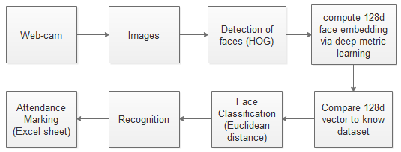
4. WORK DONE
4.1 PROCEDURE ADOPTED
Block diagram of the system

Slide 11
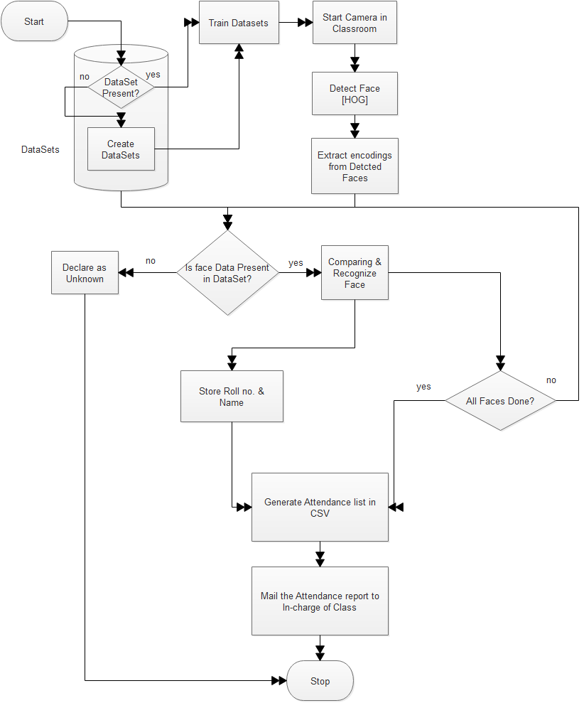
4.2 Methodology Adopted
4.2.1 Flow Diagram

Slide 12
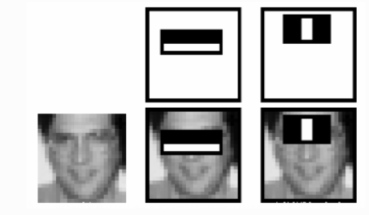
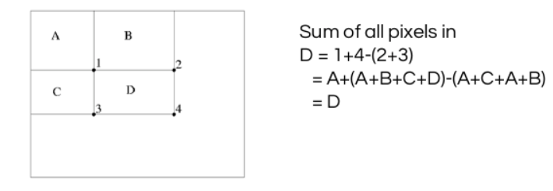
4.2.2 HAAR CASCADE
Haar-like features are digital image features used in object recognition.
Haar classifier works through following steps:
1) Haar features
These are like windows and placed upon images to compute a single feature.
2) Integral image
The integral image means to find the sum of all pixels under any rectangle by using four corner values.

Slide 13
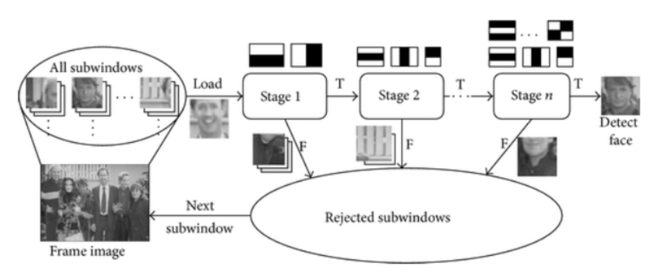
Adaboost
To only select the best feature out of the entire chunk, a machine learning algorithm called Adaboost is used.
4) Cascade of classifiers

Slide 14
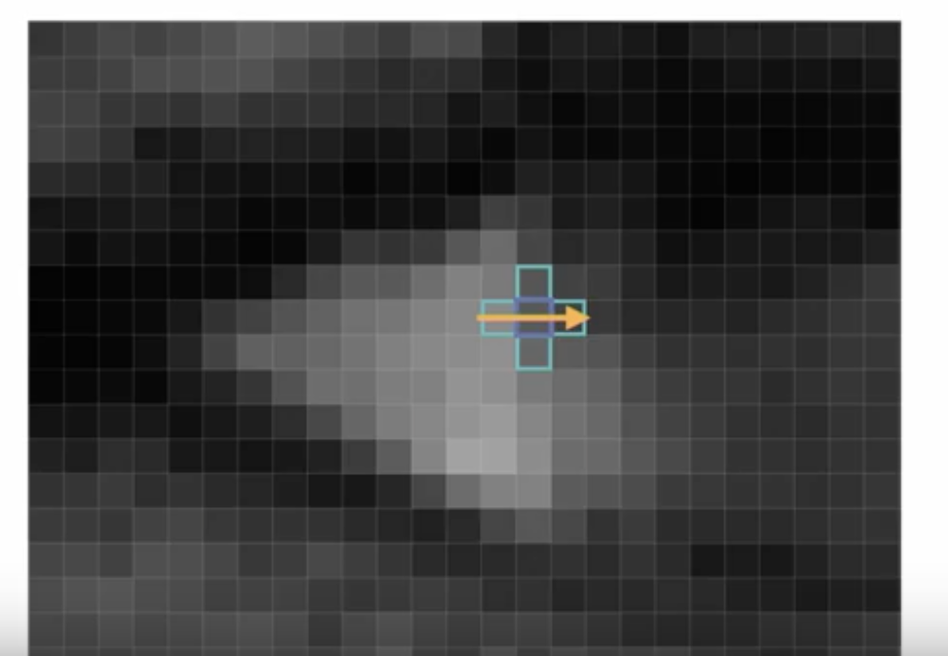
4.2.3 Histogram of oriented gradients (HOG)
Histogram of oriented gradients (HOG) is a feature descriptor.
Descriptor technique counts occurrences of gradient orientation in region of interest (ROI).
Represents a distribution of intensity fluctuations along different directions.
Steps
1) Pre-processing
Gradient vector
Gradient vector

Slide 15
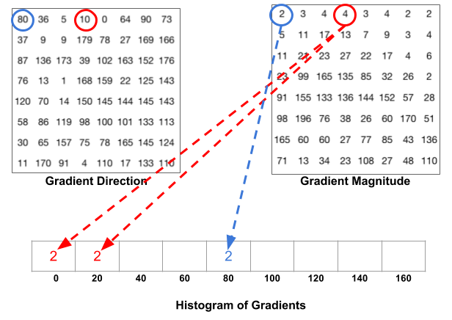
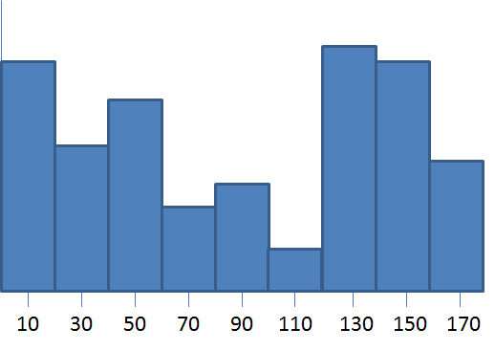
3) Histogram cells
4) Block Normalization
5) Final Descriptor Size
Block Normalization

Slide 16
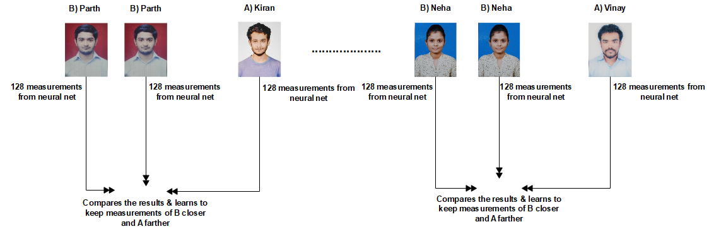
4.2.3 CNN Embeddings

Slide 17
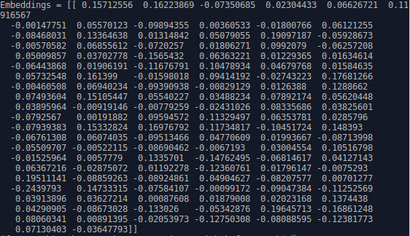

Slide 18
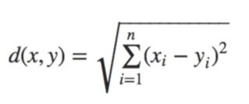
4.2.4 EUCLIDEAN DISTANCE
One of the most used distance metrics.
Used as a morphometric measure between landmarks.
Some significant distances are used to compare faces for face recognition.
Distances computed between all possible pairs the facial feature points constitute a vector of number of elements equal to the number of distances.
This vector gives the human face features of 2D image.
This vector is used as input of classification algorithm for face recognition.
Calculated using Minkowski’s Distance formula by setting p’s value to 2.

Slide 19
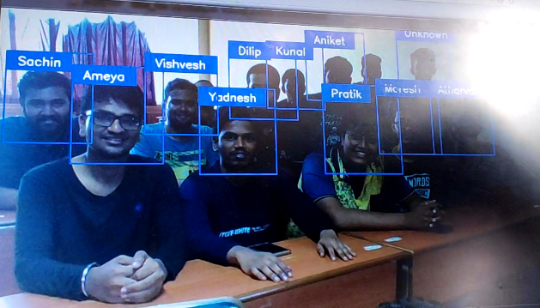
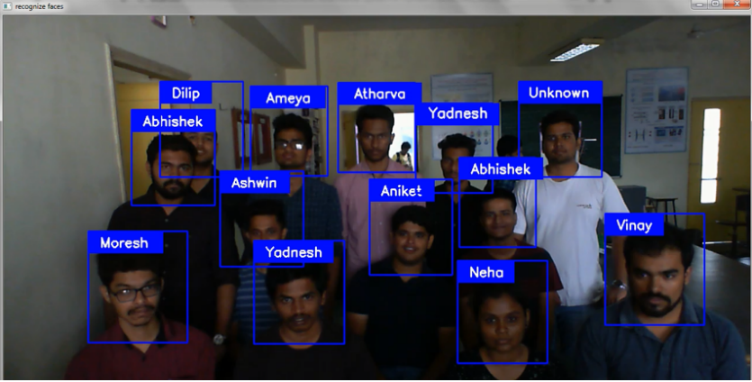
5. EXPERIMENTAL RESULTS
Case 1- Face recognition in moderate light conditions
Case 2- Face recognition in ambient light

Slide 20
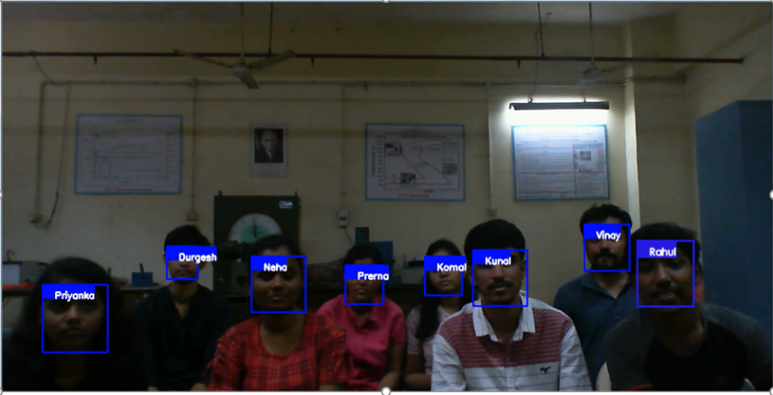
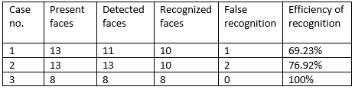
Case 3- Face recognition in ambient light with strong database
Performance of system in different scenarios

Slide 21
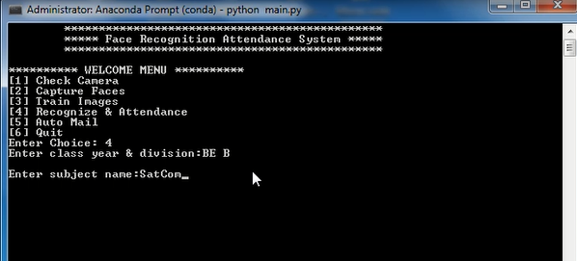
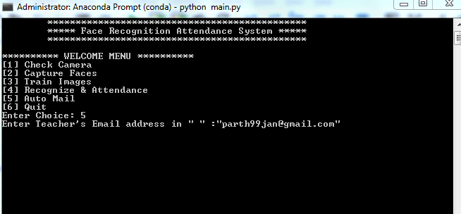
User interface of our system

Slide 22
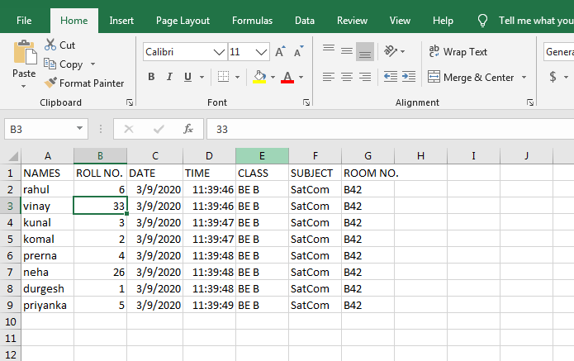
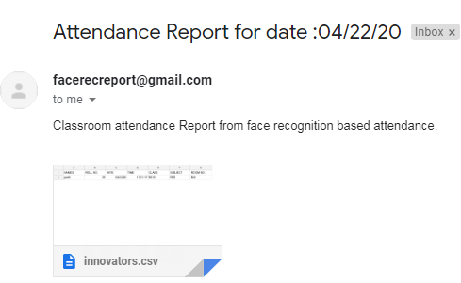
Attendance report
Email received to mentioned email address

Slide 23
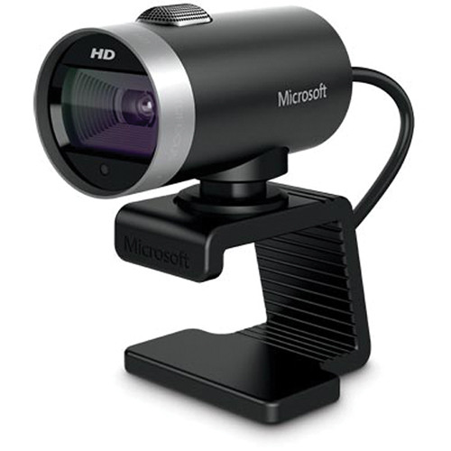
6. COMPONENT SPECIFICATIONS
Webcam-Microsoft LifeCam Cinema
720p HD video chat
Auto focus
High-precision glass element lens
TrueColor Technology with face tracking (TrueColor technology supported on Windows 8, Windows 8.1, and Windows 10)
360-degree rotation
Wideband microphone for sound recording
Wide-angle lens

Slide 24
7. COST ESTIMATION
Due to cost and other constraints, we used the web cam which are commonly available as well as economical.
Sr. No. | Particulars/ Items | Price/Rate | Quantities | Amount
1 | Web Cam (optional) | 7000 | 1 | 7000
Total Amount |  |  |  | 7000

Slide 25
  8. CONCLUSION AND FUTURE SCOPE
8.1 Conclusion
This face recognition-based attendance system was aimed to reduce the problems arising due to conventional attendance methods. Using CNN and 128-D embeddings, we have achieved sufficient recognition rate for a small classroom or a laboratory lecture. The system is very inexpensive and can be installed on any computer or PC available in classrooms of institution. Coupled with a basic user interface through which the lecturer can change the subject name every time as per the schedule along with his/her own acronym/name to further ease the process of attendance report.
8.2 Future Scope
Real-time 128-d Embedding
Making necessary improvements in CNN

Slide 26
9. ACHIEVEMENTS RELATED TO THE PROJECT
Ms. Neha Savakhande, Mr. Vinay Sripathi, Mr. Kiran Pote, Mr. Parth Shinde, Guided By: Prof. Jayant Mahajan, “Face Recognition based Attendance System: Review”, International Research Journal of Engineering and Technology (IRJET), Feb 2020, Page no. 1720.
Mr. Vinay Sripathi, Ms. Neha Savakhande, Mr. Kiran Pote, Mr. Parth Shinde, Guided By: Dr. Jayant Mahajan, “Face Recognition based Attendance System”, International Research Journal of Engineering and Technology (IRJET), Mar 2020, Page no. 1899.

Slide 27
BIBLIOGRAPHY
[1] R.Angeline, Kavithvajen.K, Toshita Balaji, Malavika Saji, Sushmitha.S.R – “CNN Integrated With HOG For Efficient Face Recognition” International Journal of Recent Technology and Engineering (IJRTE) ISSN: 2277-3878, Volume-7, Issue-6, March 2019
[2] Vishakha Mehta, Sarika Khandelwal, Ashish Kumar Kumawat- “A Survey on Face Recognition algorithm” 2018 2nd International Conference on Trends in Electronics & Informatics (ICOEI)
[3] Radhika C. Damale, Prof. Bageshree. V. Pathak – “Face Recognition Based Attendance System Using Machine Learning Algorithms” Proceedings of the Second International Conference on Intelligent Computing and Control Systems (ICICCS 2018) IEEE Xplore Compliant Part Number: CFP18K74-ART; ISBN:978-1-5386-2842-3
[4] Anushka Waingankar, Akash Upadhyay, Ruchi Shah, Nevil Pooniwala, Prashant Kasambe- “Face Recognition based Attendance Management System using Machine Learning” International Research Journal of Engineering and Technology (IRJET) e-ISSN: 2395-0056 Volume: 05 Issue: 06 | June-2018
[5] Thanh Tan Nguyen Thi, Khanh Nguyen Trong – “An Efficient Face Detection and Recognition” International Journal of Innovative Technology and Exploring Engineering (IJITEE) ISSN: 2278-3075, Volume-7 Issue-5, February, 2018
[6] Jiali Yu, Chisheng Li – “Face Recognition Based on Euclidean Distance and Texture Features” 2013 International Conference on Computational and Information Sciences 978-0-7695-5004-6/13 $26.00 © 2013 IEEE DOI 10.1109/ICCIS.2013.63

